Slide 1

A Survey on 5G Mobile Connectivity Systems and its Prospects on Communication
JAY SAMIR SHAH (1146105)
Department of Graduate Studies (Computer Science)
Lakehead University

Slide 2
Introduction
The Fifth- generation technology of tele-communication, popularly know as 5G is one of the most emerging domain of research.
The 5G is believed to bring revolution in the cellular telecommunication technology and also new generation is developed keeping in mind the elimination on the limitations of the previous generation as their primary goal.
Also, by doing so it makes it possible for many new application which require very less latency rate or very high data speeds like Mixed Reality, Internet of Things (IoT) etc. as these two factors are one of the most important requirement of the 5G services.

Slide 3
Introduction – Cont.
Many different reports have stated that the number of 5G connection will increase tremendously by year 2025 as the 5G connections will be made available.
As every technology has its own limitations, so does the 5G. There are many challenges which are faced by 5G. Some of these problem ranges from seem less connectivity issues, high bandwidth and low latency, handshaking while using mm Wave, etc.
Many different solutions for the same have been proposed by many individuals, some of them being very unique and some being extension of solutions for the existing problems.

Slide 4
Related Work
S. Sun, H. Yan, G. R. MacCartney, and T. S. Rappaport, “Millimeter wave small-scale spatial statistics in an urban microcell scenario,” 2017 IEEE International Conference on Communications (ICC), 2017.
M. Polese, M. Giordani, M. Mezzavilla, S. Rangan and M. Zorzi, "Improved Handover Through Dual Connectivity in 5G mmWave Mobile Networks," in IEEE Journal on Selected Areas in Communications, vol. 35, no. 9, pp. 2069-2084, Sept. 2017, doi: 10.1109/JSAC.2017.2720338.
M. Polese, M. Mezzavilla and M. Zorzi, "Performance comparison of dual connectivity and hard handover for LTE-5G tight integration", Proc. 9th Int. Conf. Simulation Tools Techn., pp. 118-123, 2016.
F. Al-Turjman, J. P. Lemayian, S. Alturjman and L. Mostarda, "Enhanced Deployment Strategy for the 5G Drone-BS Using Artificial Intelligence," in IEEE Access, vol. 7, pp. 75999-76008, 2019, doi: 10.1109/ACCESS.2019.2921729.

Slide 5
Proposed Methodology
As it is clear that 5G needs a lot of improvement before it is introduced commercially to the majority of the people for use.
When mobility of the users is considered it is really difficult to restrict the users with high mobility to low rates and other with high rate because it will be very challenging to maintain records as well as in the handshaking process and registration on the networks.
A very good approach regarding the same has been discussed in the paper “Improved Handover Through Dual Connectivity in 5G mmWave Mobile Networks” in which it has been proposed that the devices are always connected dually with the network as the good and long connectivity band as standby having cooperativity less data rate speed and high latency while the inner circle would be having strong connection and the full advantages of 5G network.

Slide 6
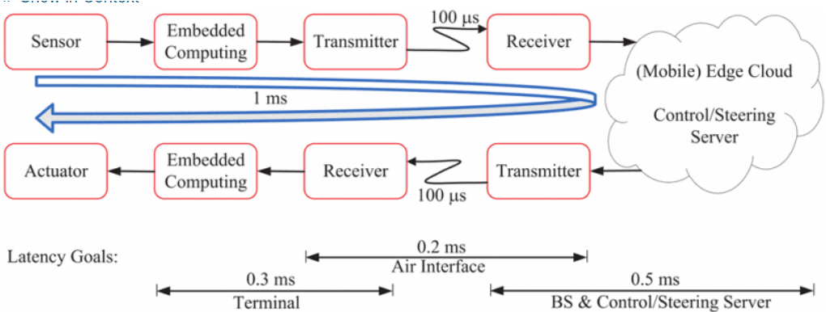
Proposed Methodology
As Well for the tactile Internet to come into picture, in which humans may wirelessly control actual and virtual objects, will not be achieved unless massive system design obstacles are overcome with the help of some method discussed.

Slide 7
Proposed Methodology
Similarly, for mm Wave behaviour in the urban setting and the related loss and detraction of wave in them, has been very well explained in “Millimeter wave small-scale spatial statistics in an urban microcell scenario”. (mmWave Characteristic with the related experiments)
A very Novel approach of connectivity with the help of drones and necessary optimization required for it in the paper “Enhanced Deployment Strategy for the 5G Drone-BS Using Artificial Intelligence”.
Doing all these it should always being kept in mind that the basic cost, efficiency, reliability, maintenance cost of the infrastructure, etc should not be increase from the current allotment else all the enhancement would be not of that much use and can would not be able to scale on large bases.
As well, the 5G infrastructure will be needed to set up because the traditional devices wont be able to sustain the requirement of the 5G systems.

Slide 8
Discussion
I have gone through many different proposed methodologies, and fond that many have assumptions taken in it which would lead to miscellaneous cost and efficiency problems in real life settings which is not acceptable.
Hence, I have just selected the methodologies, I found to be good as per my understand about the subject and having enough impact to help improve the current 5G scenario.

Slide 9
THANK YOU

